Slide 1
WITI Orange County Network Presents: Leadership Mentoring April 16, 2015
Mentor Bios

Slide 2
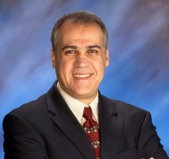
BASSAM FAWAZ
Bassam Fawaz, SVP & Chief Information Officer at PAAMCO, is a senior IT executive with broad international and business operations experience who has served as CIO for international organizations with revenues of up to $6.5 Billion, in the logistics, professional services, consumer goods, aerospace, and manufacturing industries, and held various IT and business operations responsibilities including heading worldwide operations for one of the world’s largest makers of premium products. As CIO, he has presided over global systems implementations, acquisitions integration, development and execution of strategic initiatives, and building multi-national teams on four continents. Mr. Fawaz was ranked among the InformationWeek 500, the information technology magazine’s listing of the top 500 innovator users of technology in 2006 and again in 2010.
Bassam holds a BS degree in Aeronautical Technology and an MBA, and is a Certified Professional in Business Process Management. He has held senior positions at Swiss-based Agility Global Integrated Logistics, EMAK Worldwide, B/E Aerospace, and AAR Corp

Slide 3
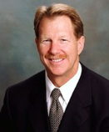
ROBERT SCHUMACHER
Robert Schumacher, Information Technology Executive. Robert has experience successfully mentoring and connecting veterans (Protégés) with corporate professionals (Mentors). Accomplished and recognized executive with broad familiarity of innovative solutions, operational controls, process improvements and performance measurements from conception to implementation for such complex disciplines as higher-education, healthcare, church management, and new digital media and entertainment services.
Provided strategic guidance and managed the initiative of an enterprise CRM solution implementation for Pepperdine University that enabled all schools to collaborate across the institution to support the entire Student Life Cycle on one single database architecture. Led the IT strategic and operational planning to achieve business goals by fostering innovation, inspiring teams, prioritizing initiatives, and coordinating the evaluation and deployment of off-the-shelf, mobile, cloud-based solutions for Christ Cathedral and Saddleback Church. For Deluxe Entertainment, secured the relationship with the Carson Entertainment Group to digitize 30 years of the Tonight Show starring Johnny Carson; directed the design, digitization and rollout of an online portal which supported the search of any word spoken (25 million words of metadata added at 99% accuracy). The results were positive with flattering news stories in The LA Times (front page), The New York Times (arts section), and an informative closing segment on the NBC Nightly News with Brian Williams and Ann Curry.
.

Slide 4
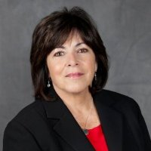
CARMELLA CASSETTA
Carmella Cassetta is a dynamic technology leader with an extensive background as a Chief Information Officer (CIO)/ Chief Technology Officer (CTO), known for providing technology enabled solutions and operations excellence that support organizational goals and solve business problems.
Ms. Cassetta has transformed IT organizations and delivered numerous technology initiatives at Ingram Micro, Barnes & Noble and Corinthian Colleges. In 2008 she was recognized with CIO Magazine "CIO 100 Innovation Award".
Carmella has diverse IT background across multiple industries including retail, global IT logistics & services and education management. Most recently she expanded into the healthcare industry, joining the IT management team for a leading healthcare organization, Hoag Memorial Hospital Presbyterian, in Newport Beach.
Ms. Cassetta graduated from the University of Connecticut with a Bachelor of Science degree in Business. Originally from Connecticut, she now resides in Newport Coast, CA with her husband Dave Loomis.

Slide 5
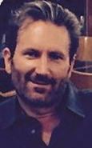
DAN VOGT
Dan Vogt started his career of 25+ years in Information Technology from a Marketing and Market Research background. First working at an Advertising Agency then Nielsen Media Research (the TV Ratings Company), and later Best Buy Corporate, Dan quickly saw the rise of importance in technology in business and made a career of utilizing smart decision making using accurate information. Entering the technology workforce as a Business Analyst, Dan moved in and out of technology roles and operational management positions until moving into senior executive leadership roles. Dan has found a home at Palace Entertainment, as the technological lead executive in the theme park, water park, animal park, family entertainment centers, and hotel industry. He is known for turning around challenged Information Technology departments.
As an Executive Director of Best Buy, Dan was responsible for integrating new acquisitions into the Best Buy portfolio of businesses. Integrating several businesses a year while increasing sales, 22%, and lower costs, 26%, on average, for the acquired businesses by increasing Marketing footprints, lowering prices through automated purchasing systems, and by lower corporate overhead through scaling parent enterprise systems.
In addition to working in technology, Dan is also a small business owner, an active fund raiser for several local charities, and a Finance committee member of the Pacific Club.
Education:
Master of Computer Science Webster University
Master of Business Administration Webster University
Bachelor of Science, Market Research Florida Atlantic University
Telecommunications Engineer Certification University of CA, Irvine

Slide 6
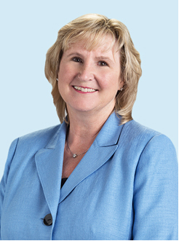
DARLENE MITCHELL
Darlene Mitchell, serves as Cydcor’s chief information officer and senior vice president of operations, where she oversees development and enhancement of technology solutions that support Cydcor and its network of independently owned sales offices. In her role as SVP of operations, Mitchell heads the compliance, quality assurance, business processes and vendor management departments. With more than 25 years of experience in designing and implementing large-scale technology initiatives in the retail, sales, and manufacturing industries, Mitchell previously held the position of Vice President and Chief Information Officer at Dunn-Edwards Corporation and Senior Manager/Advanced Development Center Leadership for Cap Gemini Ernst & Young. She also served in an IT leadership position with Hunt-Wesson, Inc.
As a technology leader with a track record of delivering leading-edge solutions to business, Mitchell focuses on introducing innovations that position Cydcor for ongoing success. She leads the development of technology initiatives that enhance information capabilities, ranging from business applications to data networking and custom information programs.
Mitchell holds a B.S. in Business Administration from the University of LaVerne. Her other achievements include "The AWT Award: Celebrating Women in Technology," a nomination for Orange County Business Journal's "Businesswoman of the Year" in 2005, and the Gartner Group's Mid-Size Enterprise "IT Executive of the Year" award.

Slide 7
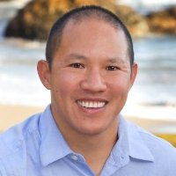
JEFF FUNG
Jeff Fung, Information Technology Leader with over 18 years’ experience building world-class teams and process, and delivering enterprise business solutions that improve the top and bottom line with the last 6 years in a senior leadership role. Experienced with designing and delivering solution for B2B, B2C, B2B2C, and international business. He has been an IT leader in different size organizations from start-ups to Fortune 500 companies. Jeff has lead rollout of ERP system to standardize business process across the company which lead to subsequence process re-engineering efforts reducing operationally expenses. He has lead multiple business process re-engineering initiatives introducing and leveraging technology to provide automation and gain efficiency resulting in cost savings.
Jeff is a technology leader combining strategic vision with tactical execution to implement new technology. Implemented Agile development methodology providing a more adaptable and dynamic software development and release cycles. Introduced and lead team on R&D and implementation of mobile applications to support changing customer needs.

Slide 8
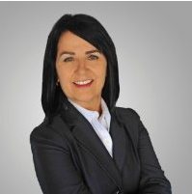
GERALDINE RAMEZANI
Geraldine Ramezani, is the Chief Technology Officer at Toyota Financial Services, a leading provider of automotive financial services with managed assets in excess of $100 billion located in Torrance, CA. Geraldine joined Toyota in 2011 and is currently responsible for core technology platforms, infrastructure and IT engineering teams. Additional responsibilities include enterprise architecture ensuring that future state and migration strategies are business aligned, capable and ready to use, as well as providing leadership and influence for TFS innovation and enterprise information management strategies.
Prior to joining Toyota Financial, Geraldine served as Managing Director, Technology Infrastructure at Auto Club of Southern California. Geraldine was instrumental in leading a major Call Center technology initiative deploying a virtual call center solution serving 2500 agents across multiple lines of business and locations in North America.
A seasoned technology executive with 25+ years of IT experience, Geraldine held senior positions at ACS/Xerox, Ingram Micro, and Sanwa Bank of California, leading global outsourcing, business transformation and technology modernization initiatives.
Ms. Ramezani earned her Bachelor’s degree in Psychology and subsequent Master’s degree in Counseling at California University, Fullerton. Geraldine also attended University of Southern California Business School and received certification in the Executive Management program.

Slide 9
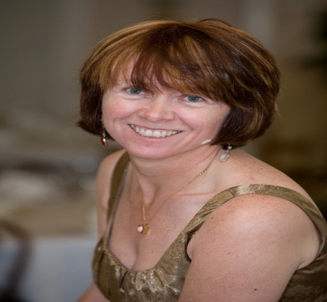
HELEN NORRIS
Helen Norris is the Vice President and Chief Information Officer at Chapman University in Orange, California. Helen has almost 30 years’ experience working in IT, where she has a proven track record of successful project delivery and a demonstrated ability to effect change. Helen has a unique blend of senior operational management skills and technology vision used to develop and implement organizational IT strategy, and prides herself on her collaborative and communication skills. Prior to joining Chapman, Helen served as the Associate CIO at California State University, Sacramento, and as a senior IT Director at the University of California, Berkeley.
Originally from Ireland, Helen has earned a Bachelor's degree in Mathematics from Trinity College, Dublin, Ireland, and a Master's degree in Computer Resource Management and Business Administration from Webster University in St. Louis. Helen has served as the Network Director for the Sacramento WITI network and on the governing board for the CIO Summit in San Francisco. She is also a board member of the National Endowment for Financial Education (nefe.org). Helen is a Fellow of the Educause Leading Change Institute and also is a certified Project Management Professional (PMP).

Slide 10
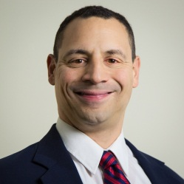
JOSEPH DESUTA
Joe Desuta is a proven leader, motivating teams that deliver IT solutions. He is Master’s prepared in both business (MBA) and technology (MS IT) with 20 years of broad-based IT management experience. Joe has excelled at using creative thinking to facilitate innovation for both growth and efficiencies and builds relationships at all levels with strong communication, interpersonal, and leadership skills. Joe has a successful track record in supporting businesses up to $162B for multiple office locations for real estate, retail and distribution industries in companies of all sizes from Fortune 50s like GMAC and ING to SMB companies such as First Team Real Estate.
As the CIO at First Team Real Estate, Joe was responsible for strategy, executive management, and support of the entire technology function for First Team and its family of companies
Earlier in his career at GMAC, Joe was promoted to CIO of the Ditech division of GMAC after successfully managing the PMO to alignment with corporate standards. Joe was responsible for the delivery of all IT projects, Change Management and Release Management functions for 2 business channels, Ditech and GMAC Mortgage Direct Lending. Joe oversaw a staff of 95 direct, indirect reports, and outsourced vendor staff and IT budgets totaling $24M per year.
Currently, Joe is consulting for Realtors Property Resource (RPR) which is the technology subsidiary of the National Association of Realtors (NAR). RPR has created powerful analytical tools for industry centered on NAR’s exclusive online real estate database, and Joe has traveled across the country providing CIO services to large broker customers of RPR.

Slide 11
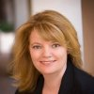
JULIE HUBBARD
Julie Hubbard is an accomplished Information Technology executive with expert skills in leading technology and software-services organizations. She currently serves as the VP of Global Infrastructure, Architecture and Technology for Edwards Lifesciences, the global leader in the science of heart valves and hemodynamic monitoring. Prior to joining Edwards she served as the Vice President of Operations for ADP, and the Vice President and General Manager of the Western US for Sprint Corporation.
Julie has a B.S. in Communications from Arizona State University. She currently serves on the Board of Directors for Advancing Women in Technology, and she is a volunteer for HOBY, a Youth Leadership Academy.
.

Slide 12
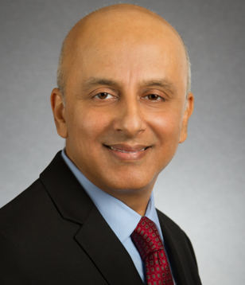
KAMAL THERANI
Kamal Tharani is a senior Information Technology Executive. As a Big 4 Sr. IT executive and C-suite advisor, Kamal has the 360 degree hands-on experience in solving complex challenges and growing profitability, quality and customer satisfaction via innovative use of technology, managing people, processes, and technology services exceeding key benchmarks.
He has directed ERP, CRM, BI/Analytics, Cloud, Mobility, Managed Services, and BPO Service Delivery, Practice Management, Operations Management and Business Development of multi-million dollar global clients, consulting practices and technology departments with P&L responsibility.
His client roster includes Fortune 500 to middle market companies in varied industries including Manufacturing, Aerospace, Utilities, Food & Beverage, Healthcare. Results supported by an MBA, PMP Certification from Project Management Institute (PMI), Certification in SAP ERP and CRM software.
.

Slide 13
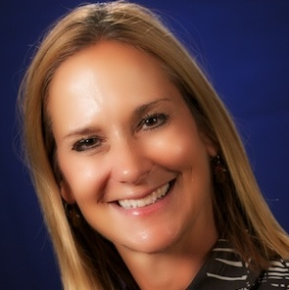
LAURA MULLER
Laura Muller is a Senior Vice President with the Capital Group Companies information Technology Group in Capital’s Irvine office. She is responsible for the American Funds Service and Retirement Plan Services technology group and the Global Business Services technology group with locations in Irvine, CA and San Antonio, TX.
Prior to joining Capital in 2006, Laura was a senior partner within the Capital Markets division of Accenture, a global consulting and technology delivery company. She also spent several years at Bank of America, where she led the Retirement Services technology and operations group.
Laura graduated from Baylor University in Waco, Texas with a BBA in Finance.
Laura plays an active role on the Technology Advisory Committee of the ICI.
She serves as a board member of St. Anne School in Laguna Niguel and the executive committee of the Shea Center.
Laura, her husband and 2 children live in Dana Point, CA.

Slide 14
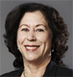
H LYNN RYAN
Lynn Ryan is the Executive Vice President and Chief Information Officer (CIO) of loanDepot. She joined the Executive Management team in February 2013.
Prior to her current role, she was Senior Vice President and CIO of CIT Group Inc. Prior to CIT, she held CIO positions with NovaStar Financial Inc., Ameriquest Capital Corp. (Ameriquest and Argent Mortgage) and Sanwa Bank. Before these CIO roles, she held senior management IT positions leading large-scale electronic banking divisions in retail, wholesale, commercial and international banking for Bank of America and Security Pacific National Bank.
Ryan has held Executive IT Leadership positions in Financial Services for over 20 years. Her expertise in Information Technology spans application development, global strategic sourcing in dual shore models, large-scale infrastructure management in centralized and decentralized complex technology environments, operations, and IT services. Ryan has significant expertise as an IT Executive and member of Corporate Executive Management delivering technology solutions for a broad range of businesses.
Ryan has been a speaker and panel moderator in financial services, banking, IT, and professional association conferences addressing a variety of IT and business topics. She served as a mentor in the CIO Pathways Program and on advisory boards of professional associations and a technology publication. Ryan was a Business Executive Advisor to six University of California institutions programs providing guidance for IT curriculum improvement and graduate and intern employment readiness. She earned a Bachelor of Science degree in Business Management from the University of Phoenix and has participated in executive IT and business programs at Harvard University, the University of Colorado and California State University.

Slide 15
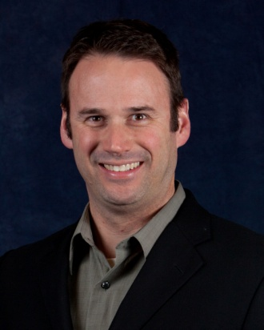
MICHAEL WOORE
With 20 years of technology and operations leadership experience at rapidly-growing and industry-leading organizations, Michael Woore is an authentic and accountable leader with a passion for creating value. Working as an internal change agent at companies such as Guthy|Renker, Technicolor, Toyota, McMaster-Carr, General Mills, and The Walt Disney Company, Michael enables new revenue streams and increases operating efficiencies, driving more dollars to the bottom line.
Michael is currently the Chief Information Officer of United Auto Credit Corporation, a national leader in subprime automotive finance that is “Driven to Make a Difference”. He holds an MBA from USC and a BBA from USD, as well as numerous technical certifications. In 1999 Michael climbed Kilimanjaro, the highest mountain in Africa. He resides in Southern California with his wife and four young sons.

Slide 16
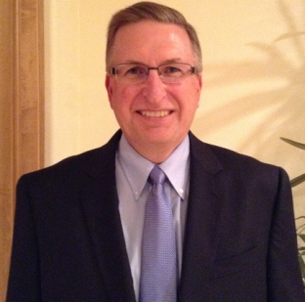
RANDY STALZER
Randy Stalzer is a Sr. Director-Software Engineering & Delivery. He is
a technology leader that is driven by the belief that strong relationships will lead to aligned thinking that results in value driven speed to market quality outcomes.
Randy has broad expertise in stakeholder engagement of enterprise-level system implementations and the delivery of strategic business solutions and customer facing e-commerce products and services.
At NCR, he was the senior division leader of the software engineering and quality assurance teams that developed and supported cloud based SaaS payment solutions for the retail industry. His leadership was a contributing factor to the double digit YoY growth they experienced.
For Experian, as key ambassador to the UK business sector, he directed the technical aspects of the business solution planning and delivery, obtaining their 5-year growth strategy from $40 million to $200 million GBP.
While at Aspen Marketing, Randy was a member of IT senior leadership team driving key company initiatives and IT organizational changes. He provided technical vision and was a key contributor during the due diligence phase that lead to the sale of Newgen Results to Aspen. He was able to demonstrate the IT value resulting in a 98% staff retention. He also lead their sever virtualization and data center relocation efforts reducing computing costs significantly.
As a Principal Consultant for eLoyalty, he was the on premise lead and had the opportunity to implement CRM solutions for Microsoft, Voice Stream (now T-Mobile) and Sprint Cellular. Establishing rapport quickly was critical.

Slide 17
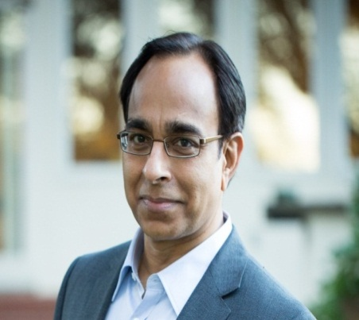
SANJAY KUCHERIA
Sanjay Kucheria is an entrepreneur and executive with over 20 years of experience, including strategy, general management, and business operations.
He serves as the CEO of Trinus Corporation, an IT Professional Services firm that specializes in business intelligence, data management, and financial performance management solutions. The firm has locations in the US and India and serves private sector companies, non-profits and government organizations. Trinus brings strong and varied vertical expertise and knowledge from Fortune 500 to mid-market and internet companies. Trinus offers turn-key managed IT services and delivers custom business intelligence solutions that use optimal technology to convert data from multiple diverse sources to the right information for the right people. Its methods are field-tested and proven and the excellent references from its clients reflect their success.
Sanjay is a member of the Young Presidents’ Organization (YPO-WPO) and Chair of its Internet & Technology Network. He serves on the USC Viterbi School of Engineering’s Department of Computer Science Advisory Board. He has also served as President of The Indus Entrepreneurs (TiE) and board member of Society of Information Management (SIM). He is a co-Founder of the USC India Alumni Association, member of Pacific Council on International Policy and TiE charter member. Sanjay continues to be a regular guest speaker at USC’s Marshall School of Business, UCI’s Paul Merage School of Business, and various business conferences.
Sanjay has a B.E. degree in Computer Engineering from the University of Bombay and an M.S. degree in Computer Science from the University of Southern California. He has taken executive education courses at Harvard Business School, including the OPM program. Sanjay is married and has two children.

Slide 18
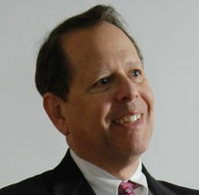
STEVE HECKLER
Steve Heckler is President and Founder of Steve Heckler Associates (SHA), a Los Angeles-based firm that specializes in executive coaching, team building and high level IT consulting. Working with business executives and their organizations, SHA advises clients from start-ups to Fortune 500 companies on key management issues including Strategic Planning, Organization Design, Team Building and Communications, Management and Leadership Training, Change Management and Disaster Recovery/Business Continuity.
Steve brings 35+ years of high technology experience to his consulting practice including key management roles with IBM, Activision, Bank of America, Lorimar Telepictures, PacTel Cellular (Air Touch), Health Net, Sony Pictures Entertainment and TVN Entertainment including 16 years as a CIO. Steve received an award from IBM for Outstanding People Management.
Steve is a strong leader who understands the relationship between I.T. and the business and is extremely effective in working with senior management in improving this relationship. He is skilled in leading, mentoring and improving effectiveness in large to small sized companies across multiple industries on a global scale as required. Included in his client list are DIRECTV, Boeing Corporation, St. Jude Medical, The Getty, AARP, First American Title Corp., SAGE Publications, CBS Television, and many others.
Steve is a BCC (Board Certified Coach). He is also a graduate of the Cal State Long Beach Coaching and Mentoring Program. Steve is the past President (2007-2008) of PCMA Los Angeles (Professional Coaches and Mentors Association). Steve is also a board member of the Southern California Society for Information Management (SCSIM) where he has served on 9 boards over 20 years, including the role of chairman. Steve has also been associated with the Westside Center for Independent Living (WCIL) where he served as a board member and chairman for 3 years on their Computer Training Project and was recognized by WCIL as the Businessman of the Year.

